Slide 1
Module 1:
Classical Supervised Models
Discriminative/ Generative Modeling
ML for Cybersecurity
November 10, 2020

Slide 2
Discriminative vs generative classification
We would like to statistically model the data:
Quantify uncertainty
Express prior knowledge / assumptions about the data
Discriminative models
aim to estimate conditional distribution P(y | x)
Generative models
aim to estimate joint distribution P(y, x)
Can derive conditional from joint distribution, but not vice versa.

Slide 3
Discriminative models

Slide 4

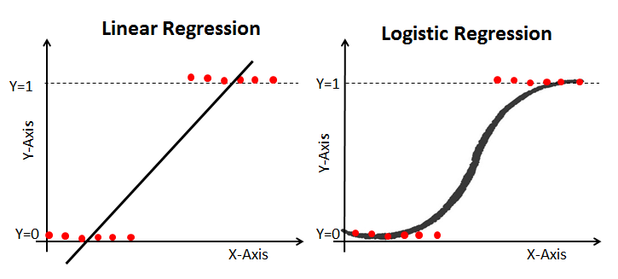
Logistic Regression
Use regression model for class probability

Slide 5
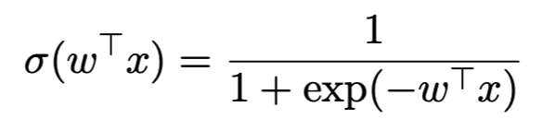
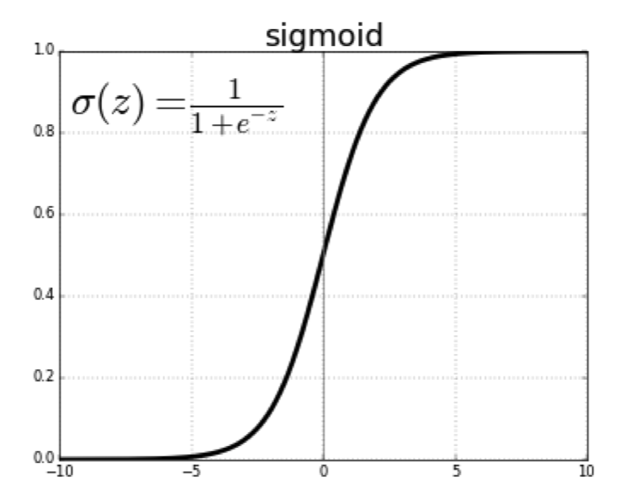
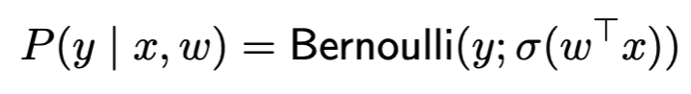
Parameter Estimation for Logistic Regression
Logistic regression assumes Bernoulli noise via a link function
Parameter could be estimated by
Maximum likelihood estimation (MLE)
Maximum a posteriori estimation (MAP)

Slide 6
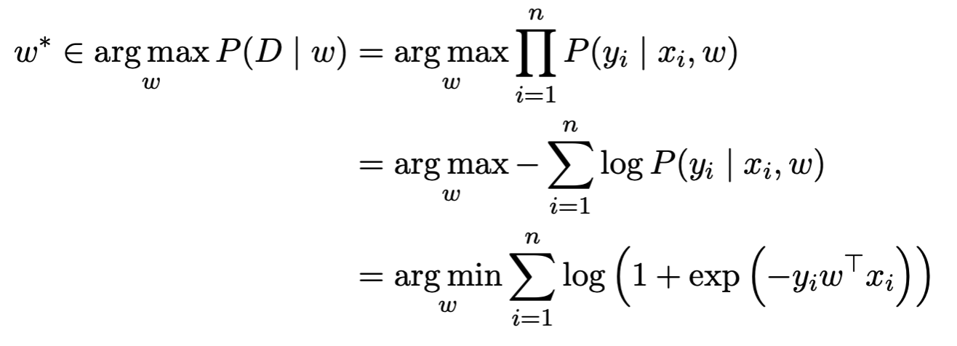
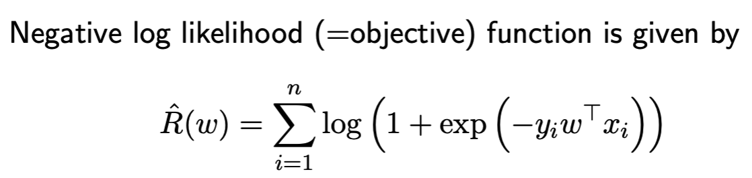
MLE for Logistic Regression
w could be efficiently optimized with (stochastic) gradient descent!

Slide 7
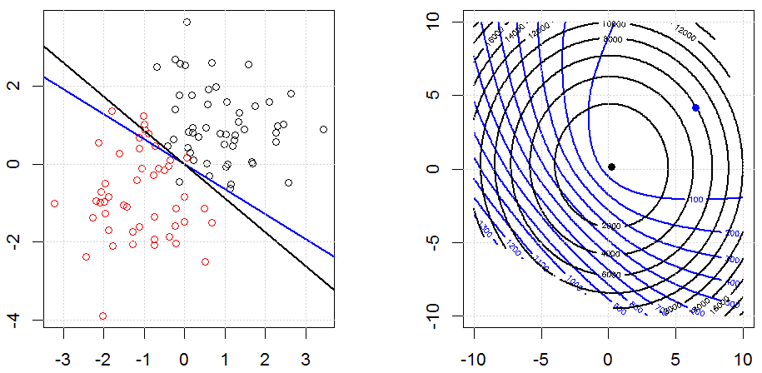
Demo
Notes:
Application – replace with cybersecurity application (spam filtering)

Slide 8
Generative Models

Slide 9
Failure Cases for Logistic Regression
What will logistic regression predict for data point x?

Slide 10
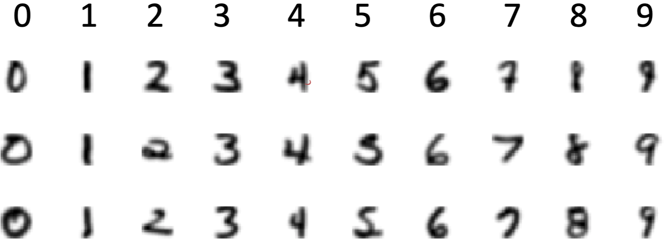
Typical Approaches to Generative Modeling
Estimate prior on labels P(y)
Estimate conditional distribution P(x | y) for each class y
Obtain predictive distribution using Bayes’ rule: P(y | x) = P(y) P(x | y) / Z
Example: hand-written digits

Slide 11
Naïve Bayes Classifier (NB)
Simple generative model
P(y)
P(x | y)
Credit @NOELIAGOROD

Slide 12
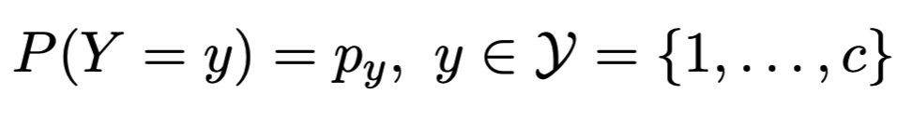
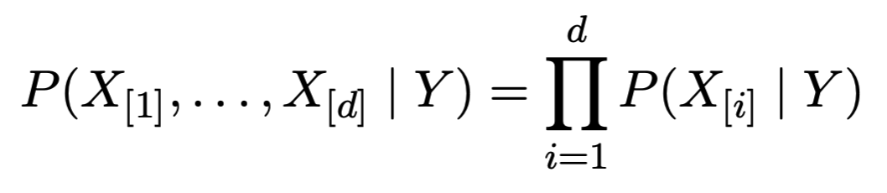
Naïve Bayes Classifier (NB)
Model class label as generated from categorical variable
Model features as conditionally independent given label
given class label, each feature is generated independently of the other features
need to specify feature distribution P(X_{[i]} | Y )

Slide 13
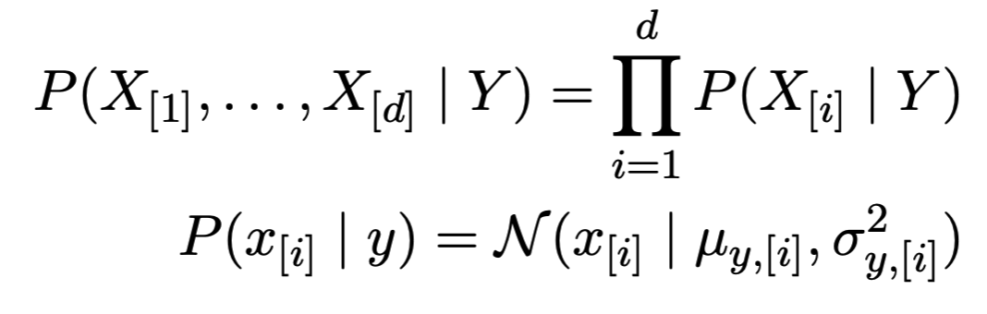
Gaussian Naïve Bayes Classifier
Model class label as generated from categorical variable
Model features as conditionally independent Gaussians
given class label, each feature is generated independently of the other features
need to specify feature distribution P(X_{[i]} | Y)

Slide 14
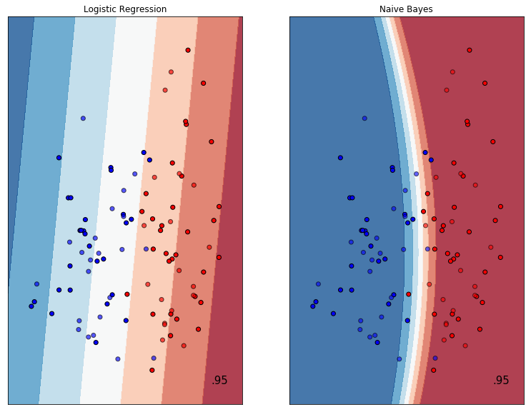
Demo: Demo: Gaussian NB vs LR (linear)

Slide 15
Demo: Gaussian NB vs LR (multi-class)

